Slide 1
MFCA STATEWIDE MEETING
MARYLAND FOOTBALL COACHES ASSOCIATION
AT THE UNIVERSITY OF MARYLAND
JONES-HILL HOUSE
MARCH 14, 2024

Slide 2
INTRODUCTIONS:
MARC MESAROS, PRESIDENT: MFCA 443-500-9351
TOM PAOLUCCI, DIRECTOR OF RECRUITING OPERATIONS, UNIVERSITY OF MARYLAND FOOTBALL
MARYLAND FOOTBALL STAFF INTRODUCTIONS:
JOSH GATTIS, OFFENSIVE COORDINATOR
BRIAN WILLIAMS, DEFENSIVE COORDINATOR
JAMES THOMAS, JR, SPECIAL TEAMS COORDINATOR

Slide 3
ALSO, WE WOULD LIKE TO THANK SPORTSYOU!
CORPORATE SPONSOR
EXTREMELY EASY TO USE/ HIGHLY RECOMMEND!
WILL BE USING THIS APP TO COMMUNICATE, USE THE WEBSITE FOR STATIC INFORMATION AND NOMINATIONS
QUESTIONS? CONTACT OUR REP

Slide 4
MFCA MEMBERSHIP
WHAT IS OUR PURPOSE?
WHY SHOULD YOU JOIN?
HOW LONG IS A MEMBERSHIP CYCLE?
ALL MUST RENEW IN SUMMER OF 2024- INSURES YOU FOR THE 2024/ 2025 AND 2025/2026 SEASONS
MUST BE A MEMBER TO:
GET THE INSURANCE
PURCHASE CAMP OR 7 ON 7 LEAGUE INSURANCE
BE INVOLVED WITH THE BIG 33 ALL STAR GAME

Slide 5
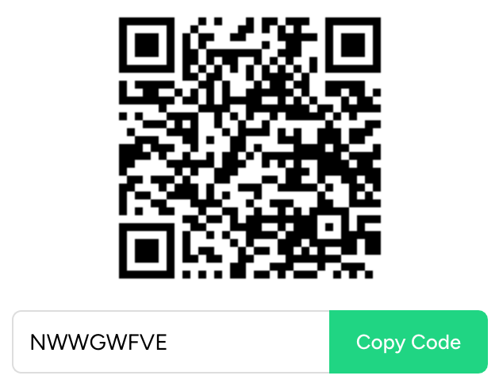
MFCA SPORTSYOU PAGE
PLEASE CLICK THE FOLLOWING QR CODE:
THIS PAGE WILL FUNCTION MUCH LIKE THE PAGE WE USED TO REGISTER FOR THIS MEETING, AND WILL ALSO BE USED TO PROVIDE UPDATES FOR:
THE MFCA/ NFF/ BTC JUNIOR DAY
THE MFCA HALL OF FAME INDUCTION CEREMONY
THE MFCA BIG 33 CLASSIC
NOTE: EVERYONE WILL NEED TO RENEW IN AUGUST, SINCE THIS IS THE SECOND YEAR OF OUR TWO-YEAR CYCLE!

Slide 6
MFCA HALL OF FAME INDUCTION CEREMONY
MARC MESAROS, CHAIRMAN
SATURDAY, APRIL 27 AT UMD GOSSETT TEAM HOUSE 9:00 AM TO 11:00 AM; WINNERS WILL BE RECOGNIZED ON THE FIELD AT HALFTIME OF THE UMD SPRING FOOTBALL GAME
NEW DEVELOPMENT: HOF INDUCTEES WILL BE RECOGNIZED ON THE FIELD AT THE BIG 33 ALL-STAR GAME!
WE ARE ASKING FOR HELP ON THIS GREAT DAY; WE WOULD LIKE:
TWO COACHES TO HELP WITH SET UP/ CLEANUP
TWO COACHES TO HELP WITH SHEPHERDING PEOPLE TO THE AUDITORIUM AND TO THE FIELD AFTER THE CEREMONY
ONE COACH TO PICK UP REFRESHEMENTS (REIMBURSED)

Slide 7
THE MFCA/ NFF/ BTC JUNIOR DAY
MARC MESAROS, CHAIRMAN
WILL BE ON EITHER SUNDAY APRIL 28TH OR SUNDAY MAY 5TH AT THE RAVENS INDOOR FACILITY
PURPOSE IS TO IDENTIFY PROSPECTIVE BIG 33 PLAYERS IN THEIR JUNIOR YEAR
THIS IS NOT FOR EVERYONE- IF HE’S NOT A STARTER IN HIS JUNIOR YEAR, HE SHOULDN’T BE IN THE LIST
HAD ABOUT 93 KIDS LAST YEAR, GOAL IS 120 KIDS THIS YEAR
OL CHECK IN 8:30 AM/ CAMP RUNS FROM 9:00 AM TO 11:00 AM
SKILL CHECK IN 10:30 AM CAMP RUNS FROM 11:00 AM- 1:00 PM
COST WILL PROBABLY BE $25; WE WILL USE THE SAME REGISTRATION MODEL AS LAST YEAR
COACHES AND PLAYERS MUST FILL OUT AND SUBMIT ONLINE WAIVER AS PER BALTIMORE RAVEN’S REQUIREMENTS

Slide 8
THE MFCA/ NFF/ BTC JUNIOR DAY
HOW IT WORKS:
OL/ DL: 8:30 AM REGISTRATION/ 9:00 AM TO 11:00 AM CAMP
WARM UP (10 MINUTES)
OL/ DL (30 MINUTES): INDIVIDUAL- THREE 10 MINUTE STATIONS
OL/ DL GROUP (20 MINUTES): OL- GROUP PASS PRO TEACHING/ DL- PASS RUSH LANES, GROUP PASS RUSH
OL/ DL- PASS RUSH ONE ON ONES (20 MINUTES)
QB/ RB/ WR-TE/ LB/ DB: 10:30 AM REGISTRATION/ 11:00 TO 1 PM CAMP
WARM UP (10 MINUTES)
WR/ RB (30 MINUTES): INDIVIDUAL- THREE 10 MINUTE STATIONS
QB WARM UP/ MECHANICS/ DROPS/ DRILLS
ALL- GROUP (30 MINUTES): HALF LINE PASSING (NO 7 ON 7– COLLISIONS)
ALL- ONE ON ONES (20 MINUTES)

Slide 9
THE MFCA/ NFF/ BTC JUNIOR DAY
POINTS OF CONTACT:
QB- KURT STEIN, HEAD COACH: OAKDALE HIGH SCHOOL
WR- MILES GRAY, FORMERLY OF NORTHWEST HIGH SCHOOL
RB- MONTE SUTTON, HEAD COACH: FREDERICK DOUGLASS HIGH SCHOOL
OL- BRENDAN RILEY, HEAD COACH: PARKSIDE HIGH SCHOOL
DL- DAN YARBOROUGH, CONCORDIA PREPARATORY HIGH SCHOOL
LB- TOM ABLE, HEAD COACH: DUNDALK HIGH SCHOOL
DB- SEAN SANDORA, HEAD COACH: PERRYVILLE HIGH SCHOOL

Slide 10
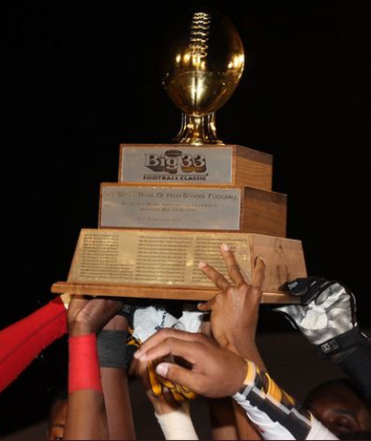
BIG 33 ALL-STAR GAME UPDATE: BRIAN VAN DEUSEN

Slide 11
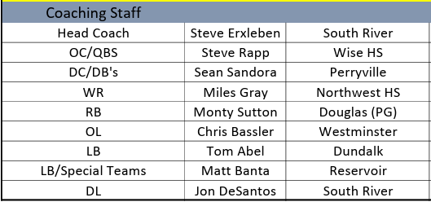

Slide 12
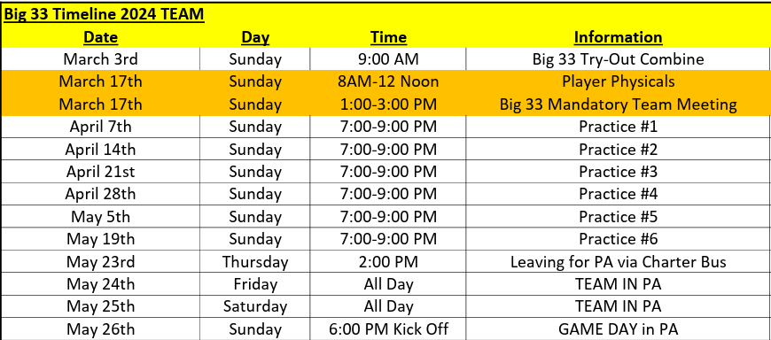

Slide 13
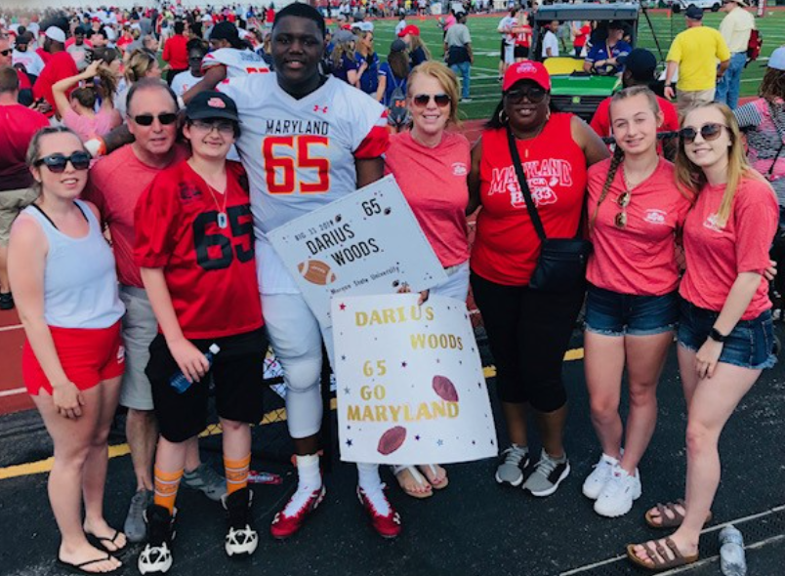
Host Family and Buddy program

Slide 14
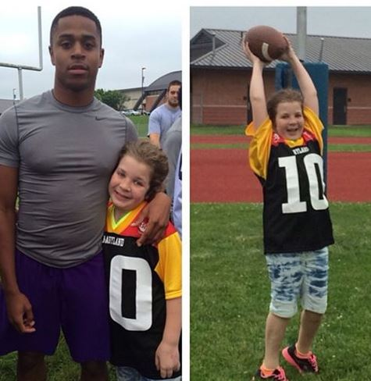
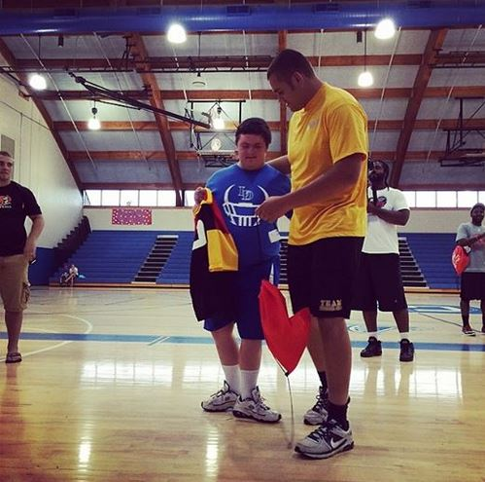
Big 33 Buddy Program

Slide 15
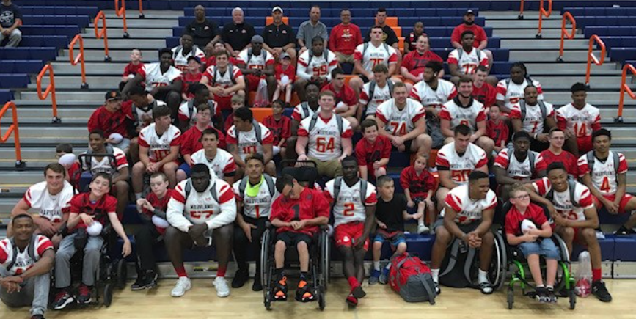

Slide 16
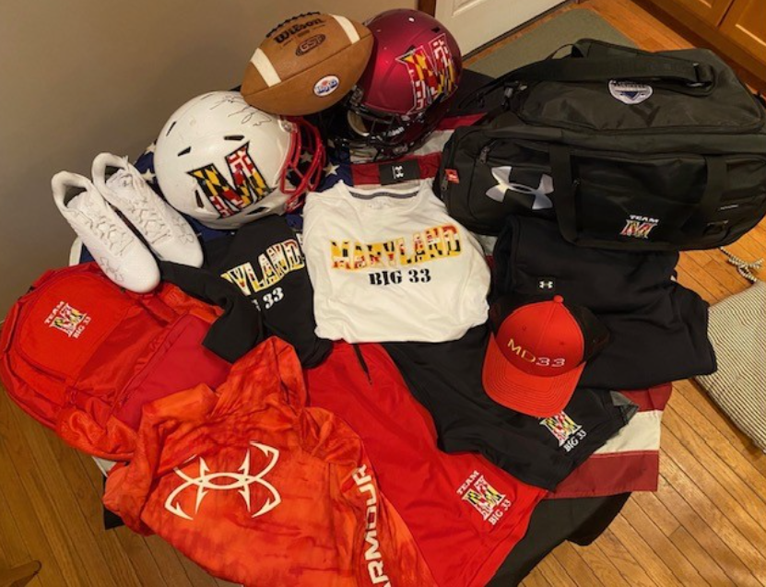
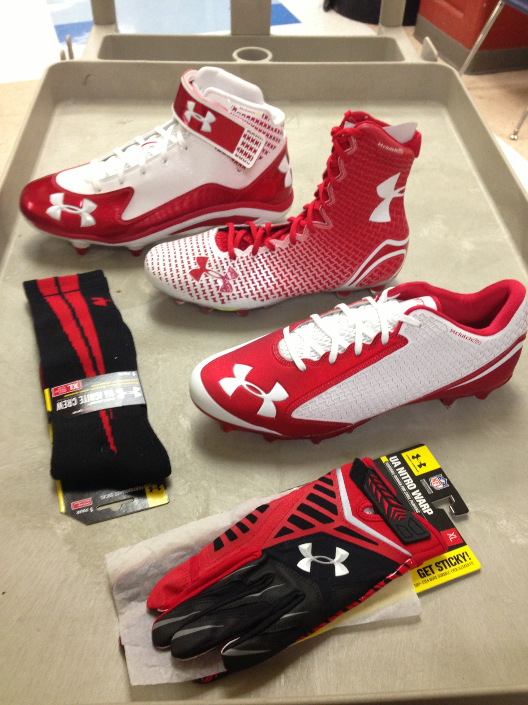
Team MD Players Gear

Slide 17
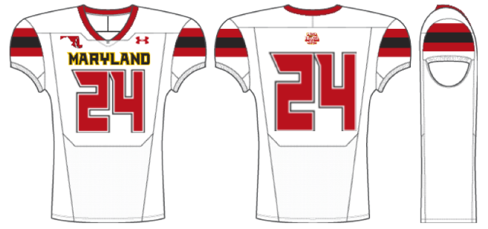
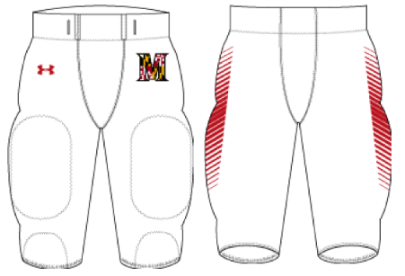
2024 Uniform

Slide 18
MFCA BIG 33 CLASSIC ALL- STAR GAME: COACHING STAFF
NEW: SELECTION COMMITTEE TO PICK NEXT STAFF BEING FORMED:
MAKE UP- MFCA ADMIN PLUS SOME COACHES WHO HAVE COACHED IN THE GAME
NOMINATION FORM- LINK WILL BE ON MFCA SPORTS YOUPAGE
NOMINEE MUST BE AN MFCA MEMBER
TO BE A HEAD COACH, MUST HAVE BEEN AN ASSISTANT IN THE GAME
TIMELINE- ATTEMPTING TO HAVE STAFF PICKED BY THE JUNIOR DAY
Link:
Click Here to Nominate!

Slide 19
UNIVERSITY OF MARYLAND SPRING FOOTBALL ACTIVITIES
TOM PAOLUCCI- UNIVERSITY OF MARYLAND DIRECTOR OF RECRUITING OPERATIONS
SPRING PRACTICE UPDATES
SPRING CLINIC UPDATE
CAMPS

Slide 20
THIS CONCLUDES THE MEETING
BEER!
CLINIC UP WITH COACHES GATTIS, WILLIAMS, AND THOMAS!
NEXT MEETINGS:
UNIVERSITY OF MARYLAND CLINIC- BRIEF MFCA MEETING DURING THE CLINIC

